Slide 1

VEHICLE MARKET INSIGHTS DASHBOARD
PRESENTED BY ADHWAI

Slide 2
Purpose & Motivation
I have a strong interest in the automotive and sales sectors, and this project provided an opportunity to analyse the dataset in depth, uncover actionable insights, and combine my technical skills with my enthusiasm for the industry.

Slide 3





Audience
Designed for sales executives across different brands.
Executives can filter by brand, and the dashboard dynamically updates to provide key insights, helping them make informed inventory, pricing, and marketing decisions.

Slide 4

Identify Key Market Trends
Determine top-selling models, peak sales periods, popular body types, and regional variations to uncover actionable patterns in the U.S. used car market.
Project Objectives
Analyse Customer & Dealership Behaviour
Examine dealership performance, trim preferences, pricing, colour choices, transmission types, and model years to understand factors driving sales.
Support Strategic Decision-Making
Provide sales executives with a dynamic, interactive dashboard to compare models, assess competitors, and make informed inventory, marketing, and pricing decisions.

Slide 5





Key Insights
Overall Market Performance
Regional Preferences
548K vehicles sold generating ~$7.51B.
Ford leads with 94K units ($1.36B).
Sedans dominate California, Florida, Pennsylvania
Pickups lead in Texas (Ford F-150).
Top-Selling Model
Seasonal Trends & Pricing
Nissan Altima - 19K units sold
$221M revenue
popular trim 2.5S
99% automatic.
Peak sales Jan–Feb
Median price $12K–$14K
F-150 median $19K.

Slide 6

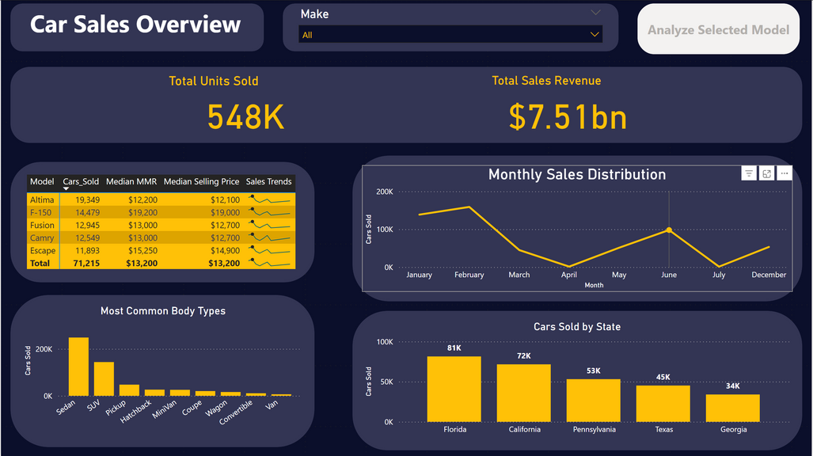
Dashboard Preview
Shows overall sales performance and trends across all car models.
Key Metrics: Total units sold & revenue.
Top Models: Matrix of top 5 models with median price & MMR; sparklines show trends.
Trends & Distribution: Monthly sales, body type breakdown, top states.
Interactive Filters: Explore by period, body type, or model for focused insights.

Slide 7
Helps executives prioritize inventory by model, body type, and region.
Business Impact
Supports pricing and marketing strategies aligned with customer preferences.
Provides a dynamic, interactive tool for exploring trends and performance metrics.

Slide 8
Thank you
Explore the dashboard: https://github.com/Adhwai07/Vehicle-Market-Insights-Dashboard

